Slide 1
REST

Slide 2
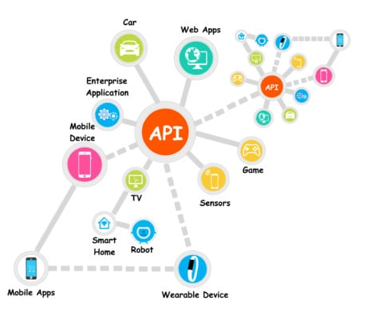

Slide 3



Rest based architecture
API
Business Logic

Slide 4
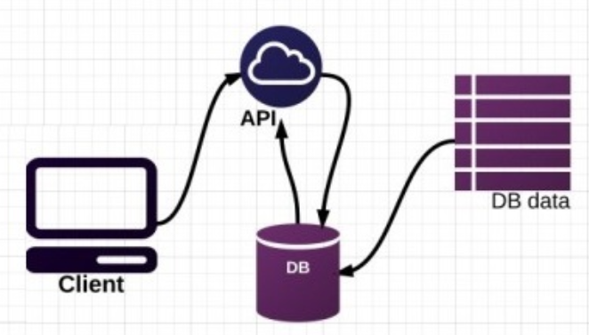
REST exposes database as a service

Slide 5
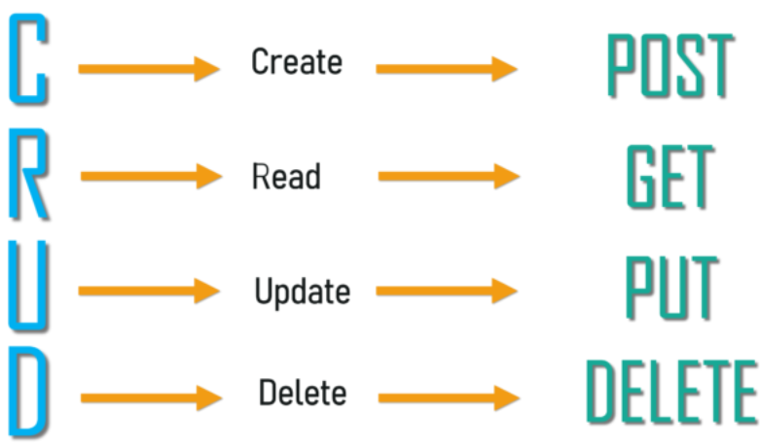
REST support CRUD

Slide 6
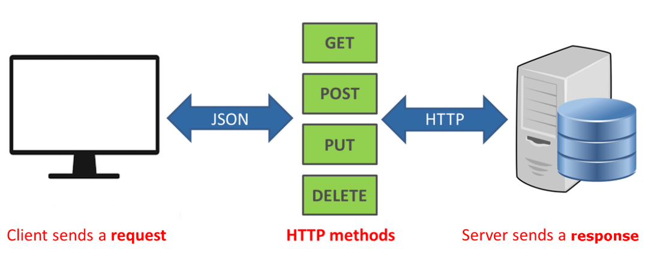
Rest in action
GET | Retrieves data from a remote server. It can be a single resource or a list of resources.
POST | Creates a new resource on the remote server. *
PUT | Updates the data on the remote server.
DELETE | Deletes data from the remote server.

Slide 7
10 most common response codes
Code | Message | Description
200 | OK | The data was received and the operation was performed.
201 | Created | The data was received and a new resource was created. The response needs to return the data in the payload.
204 | No content | The operation was successful but no data is returned in the response body. This is useful when deleting a resource.
301 | Moved permanently | This and all the future requests should be redirected to a new URL.
302 | Moved temporarily | The resource moved temporarily to another URL.
400 | Bad request | The server cannot accept the request because something is wrong with the client or the request that it sent.
403 | Forbidden | The client is not allowed to use the resource.
404 | Not found | The computer is not able to find the resource.
405 | Method not allowed | For example, when sending a DELETE request to a server that doesn't support the method.
500 | Internal server error | Service unavailable due to error on the server side.

Slide 8

Growing list of REST testing tools

Slide 9
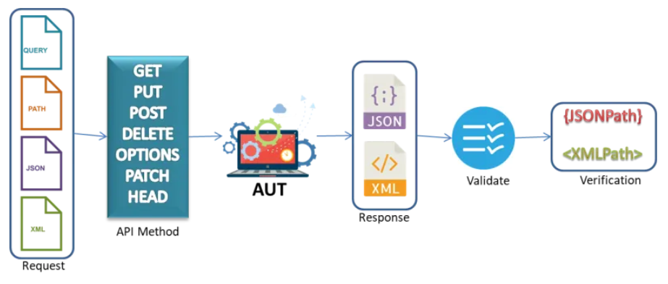
Rest test flow

Slide 10
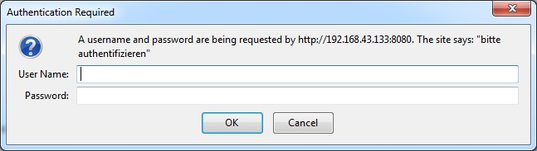
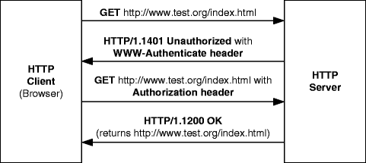
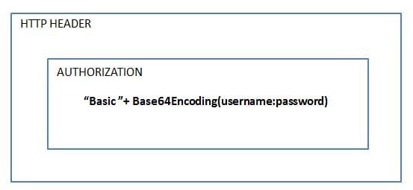
Challenges

Slide 11
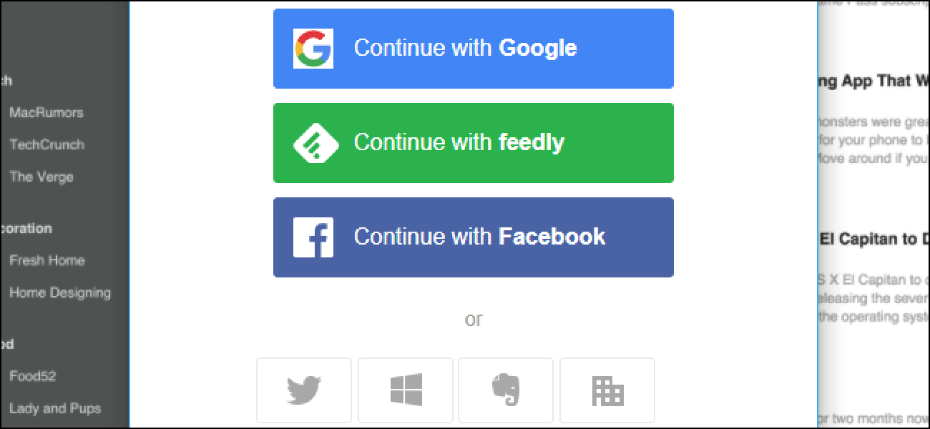
OAuth authentication

Slide 12
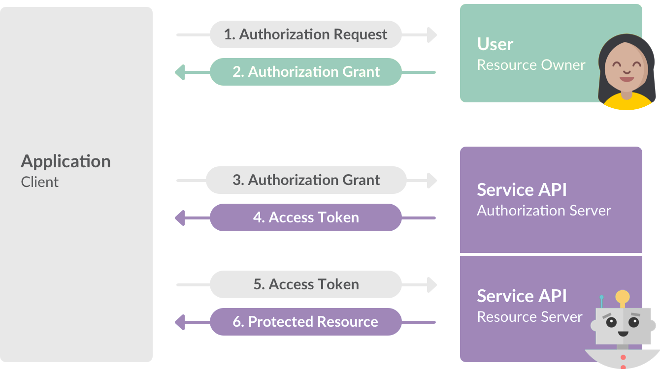
OAuth authentication

Slide 13
API Test structure for Projects
Test Suite(s) (Smoke, Sanity, Regression, Functional, Performance, Security)
Test cases
Test Steps
Connect to API with necessary authentication inputs and retrieve the session ids
Use the session ids in all the subsequent requests
Perform some get operation(s) and assert response codes for each of the above responses
Perform some post operations(s) and assert response codes
Use data driven approach to achieve high coverage

